Slide 1
Cluster Analysis
Creating clusters on Global Development Measurement Dataset.
This dataset has information about important economic and development metrics related to various countries across the Globe.

Slide 2
The problem
For any company to set up their business in any country, they need to know what would their investment would be? If they can set up a business there? What are the Country’s Tax laws? What is the expected growth? Will the business make profit? Etc…
2020 | 2021 | 2022 | 2023

Slide 3

The solution
Presenting the information about list of countries that fall under category of “Under Developed”, “Developing” & “Developed” countries.
By providing this information, the company can take a informative decision towards their growth of company.

Slide 4
Features in dataset
Birth Rate
Business tax
CO2 emissions
Country
Days to start business
Ease of business
Energy usage
GDP
Health exp % GDP
Health exp / Capita
Hours to do tax
Infant Mortality
Internet usage
Lending rate
Life expectancy female
Life expectancy male
Mobile phone usage
Number of records
Population 0-14
Population 15-64
Population 65+
Population total
Population urban
Tourist Inbound
Tourist Outbound
Notes:
Birth Rate : rate at which birth occur
Business tax : business tax related calculations as per country's law
CO2 emissions : CO2 emission in atmosphere
Country : name of country
Days to start business : days required
Ease of business : how easily we can start/run the business in that country
Energy usage : total amount of energy consumption in the country
GDP : Gross Domestic Product (GDP) is country's measure of economic output. Total goods/services produced within a country within a year.
Health exp % GDP : amount spent on health expenses from GDP
Health exp / Capita : amount spent on health expenses per individual
Hours to do tax : time required for tax calculations
Infant Mortality : number of infants deaths / 1000 birth
Internet usage : Ratio of population using internet
Lending rate : rate of interest provided by banks of country
Life expectancy female : average number of years female expected to live
Life expectancy male : average number of years male expected to live
Mobile phone usage : total amount of population using mobile phones
Number of records : observations in the dataset
Population 0-14 : total number of individuals with the range of 0-14 age
Population 15-64 : total number of individuals with the range of 15-64 age
Population 65+ : population above the age of 65+
Population total : total population of country
Population urban : amount of population in urban areas
Tourist Inbound : total amount of inbound tourism for that country
Tourist Outbound : total amount of inbound tourism for that country

Slide 5
THE PROCESS
1)Exploratory Data Analysis(EDA)
Read data.
Checking basic info(head, tail, info, describe)
Dropping unwanted columns.
Checking for duplicates.
Proper data type conversion.
Renaming columns.
Handling null values - Using KNN imputer.
Correlation analysis - we have used heatmap.

Slide 6
Outlier detection - we have used box plot and iqr method.
Data transformation - We did standardisation.
Dimensionality reduction - we have used PCA.
2) Model Building
K-Means clustering.
Hierarchical clustering.

Slide 7
Gaussian Mixture Model clustering.
Dbscan clustering.
3) Model evaluation
Silhouette method.
Davies-Bouldin index method.
4) Model deployment

Slide 8
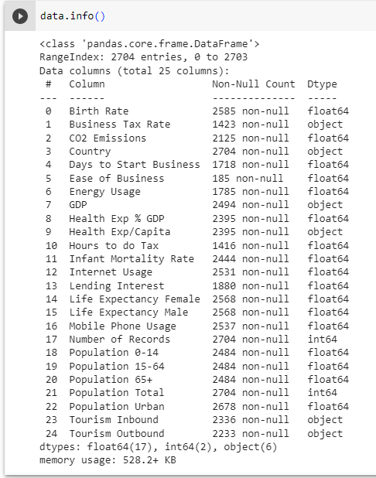
The solution
1)EDA
The info() method prints information about the dataset.
From here, we can understand that there are 25 columns and 2704 rows in the dataset.
Columns are of float, object and int data type.

Slide 9
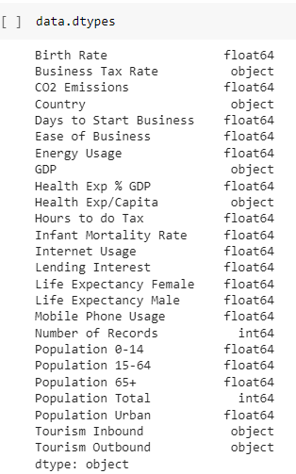
The solution
Here, business tax rate, GDP, health exp/capita, tourism inbound and tourism outbound are of object data type. They need to be converted into their proper data type.

Slide 10
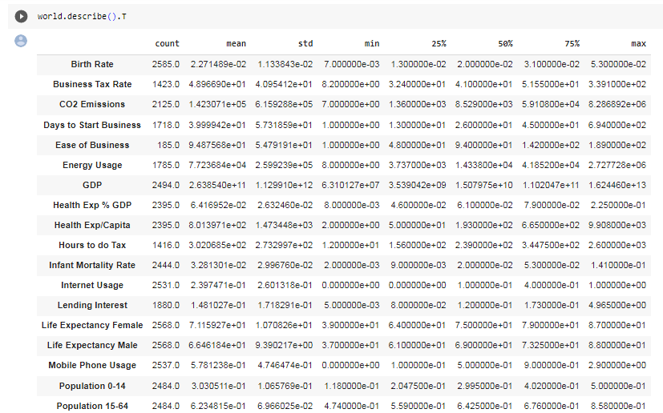
From here, we found that standard deviation of ‘No.of records’ column is 0. Standard deviation 0 means same record is present in every row. So dropping that column.

Slide 11
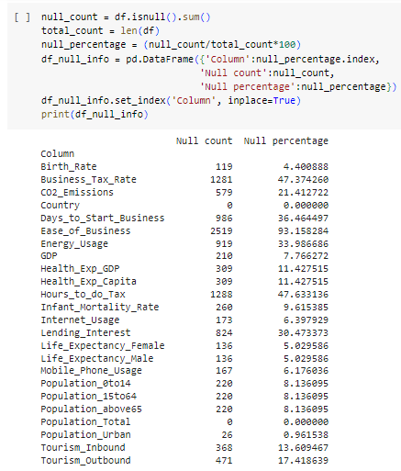
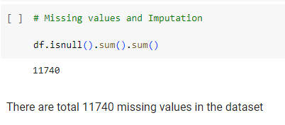
Checking for null values.
There are total 11740 null values in the dataset.
Here, Ease of business contains more than 90% of null values. So dropping that column and Population Urban contains the least number of null values.

Slide 12
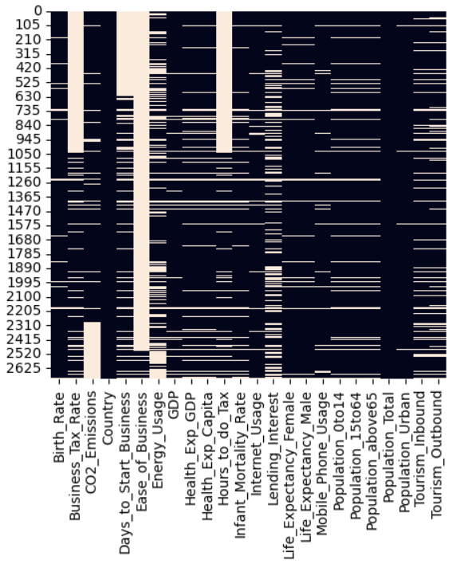
Visualising the null values using heatmap.
Black : Non-Null values
White : Null values
Notes:
“Country” column has no null values where as “Ease of Business” has maximum null values

Slide 13
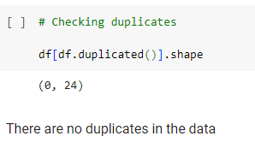
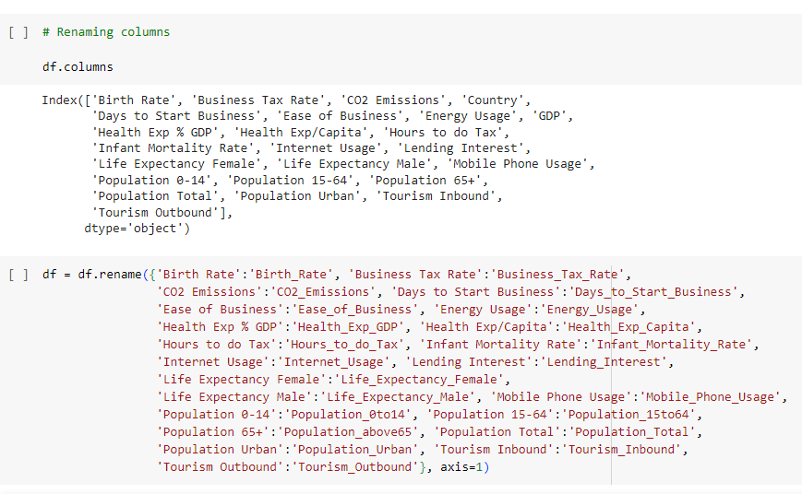
Checking for duplicate values.
There are no duplicate values present in the data.
Renaming columns because some columns contain spaces and special characters. So we need to remove them.

Slide 14
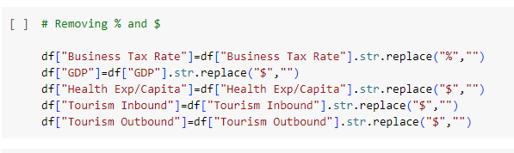
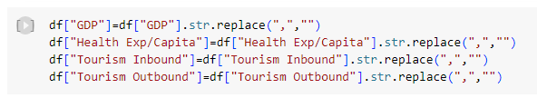
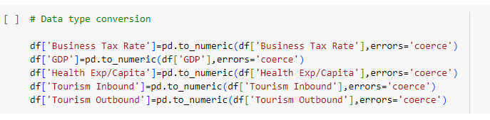
The solution
Removing Special Characters

Slide 15
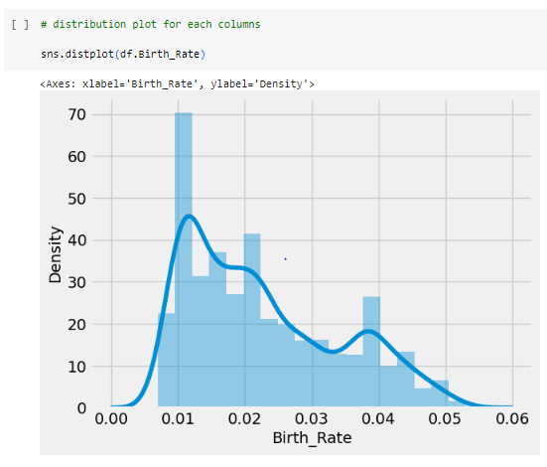
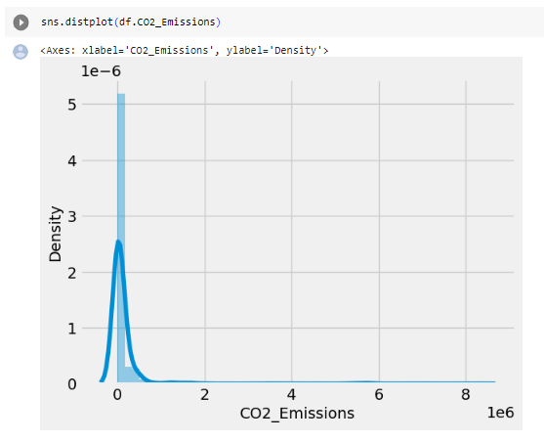
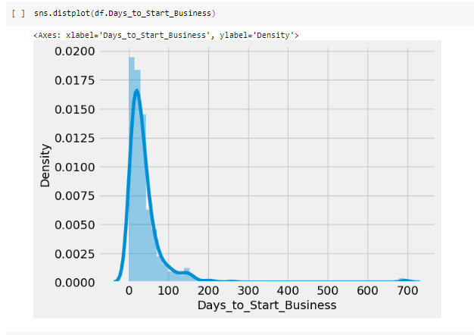
Distribution plot for every columns to check the distribution of data

Slide 16
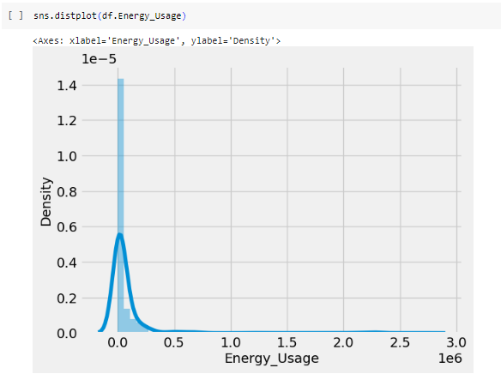
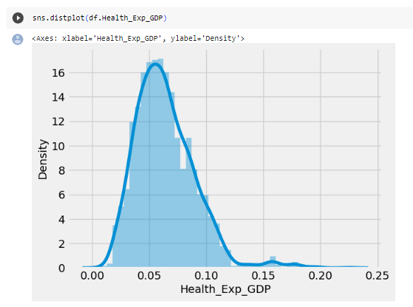
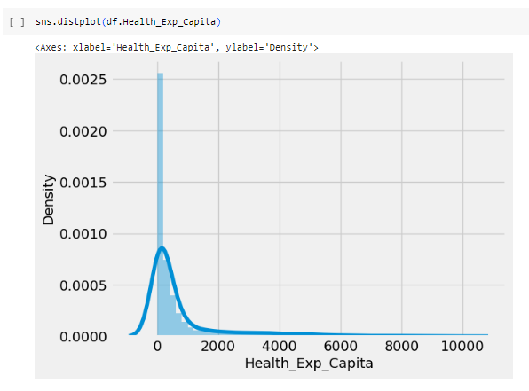
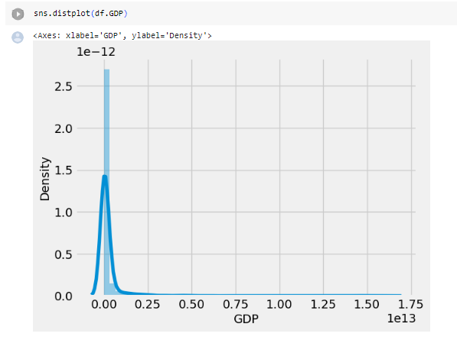
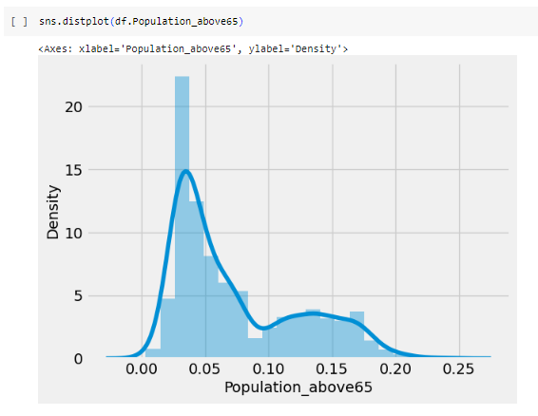
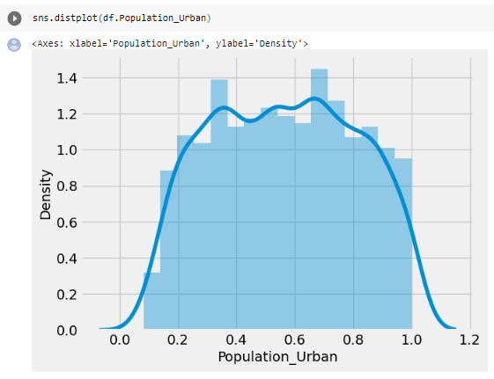

Slide 17
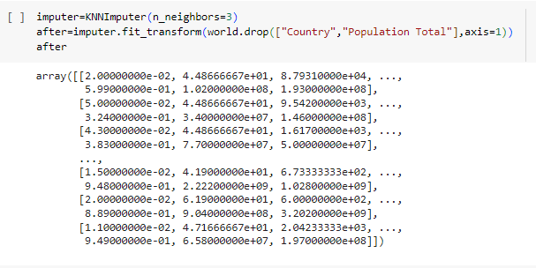
Handling null values using KNN imputer

Slide 18
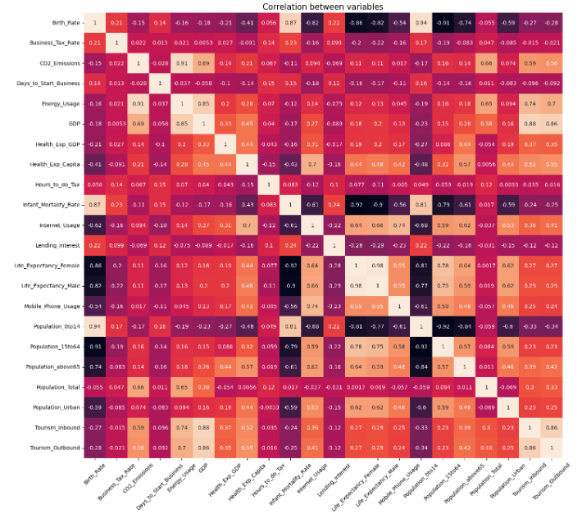
Correlation Analysis
Birth rate is positively correlated with population 0 to 14.
Life expectancy female of male is positively correlated.
Energy usage is positively correlated with co2 emission.
Tourism Inbound is negatively correlated with birth rate.
Population urban and business tax rate has a negative correlation.
Notes:
Correlation matrix gives the magnitude of correlation between the features, positive sign shows the direct correlation and negative sign shows indirect or inverse correlation.
Birth Rate: It is positively correlated with population 0-14 and infant mortality rate.

Slide 19
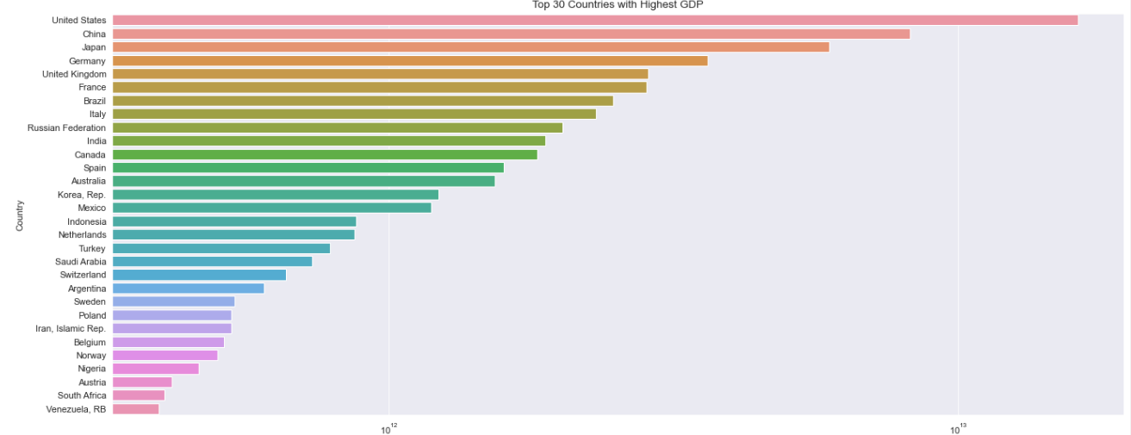
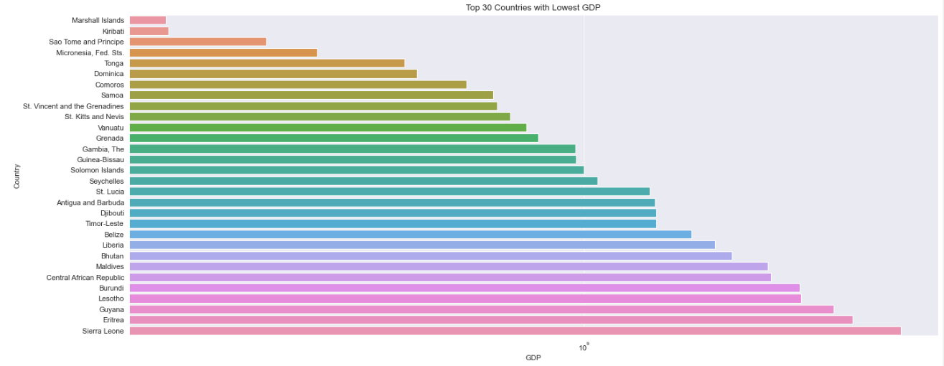
Insights
Top 30 countries with Highest and
Lowest GDP

Slide 20
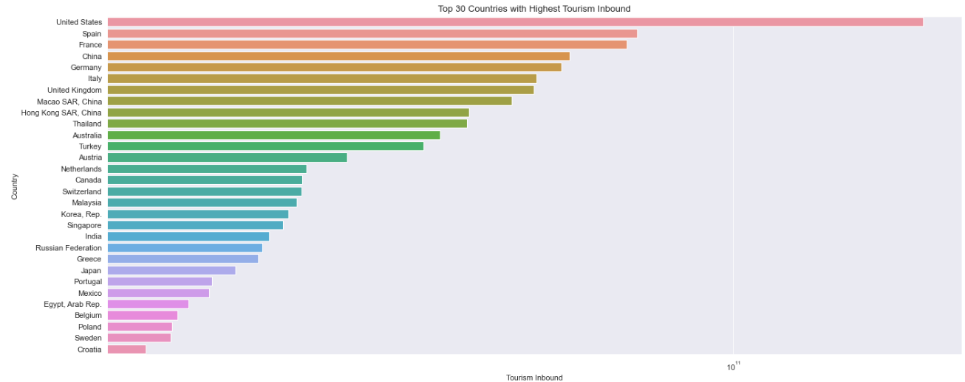
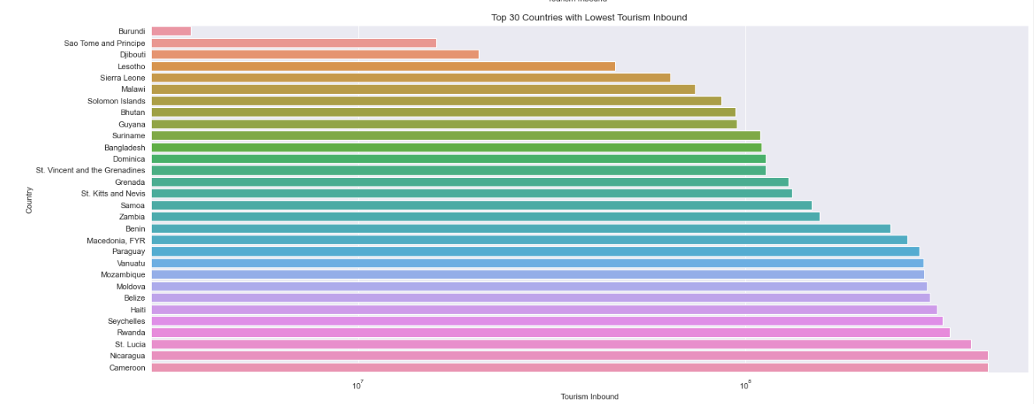
Insights
Top 30 countries with Highest &
Lowest Tourism Inbound

Slide 21
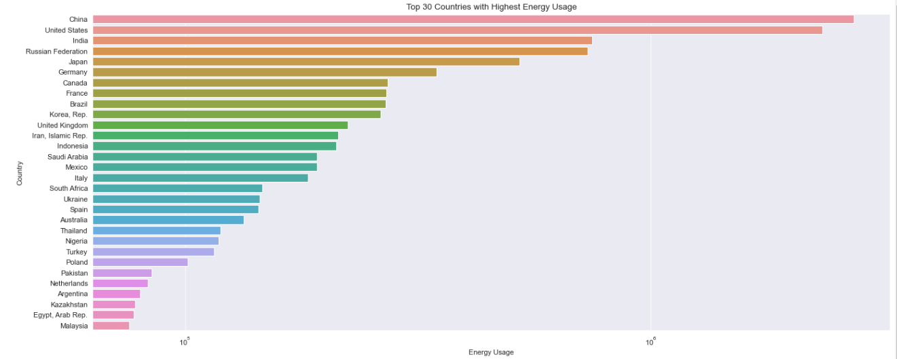
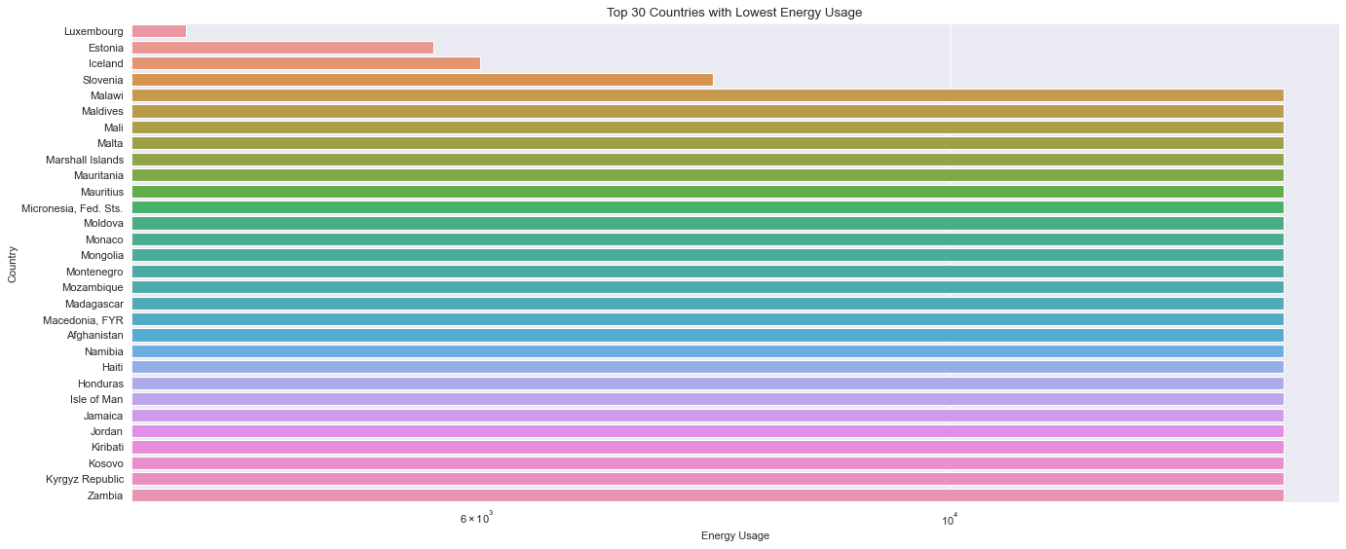
Insights
Top 30 countries with Highest &
Lowest Energy Usage

Slide 22
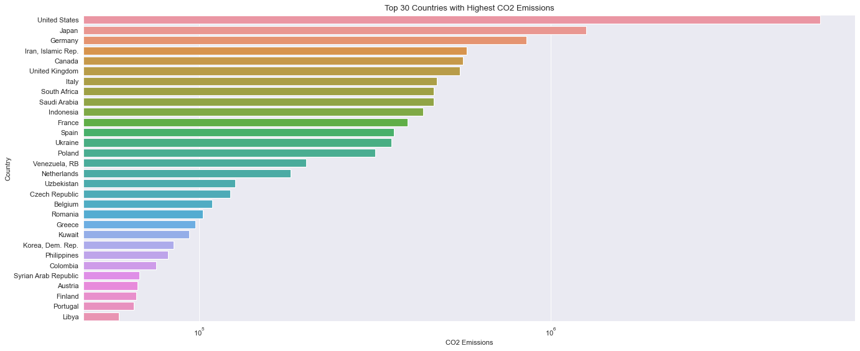
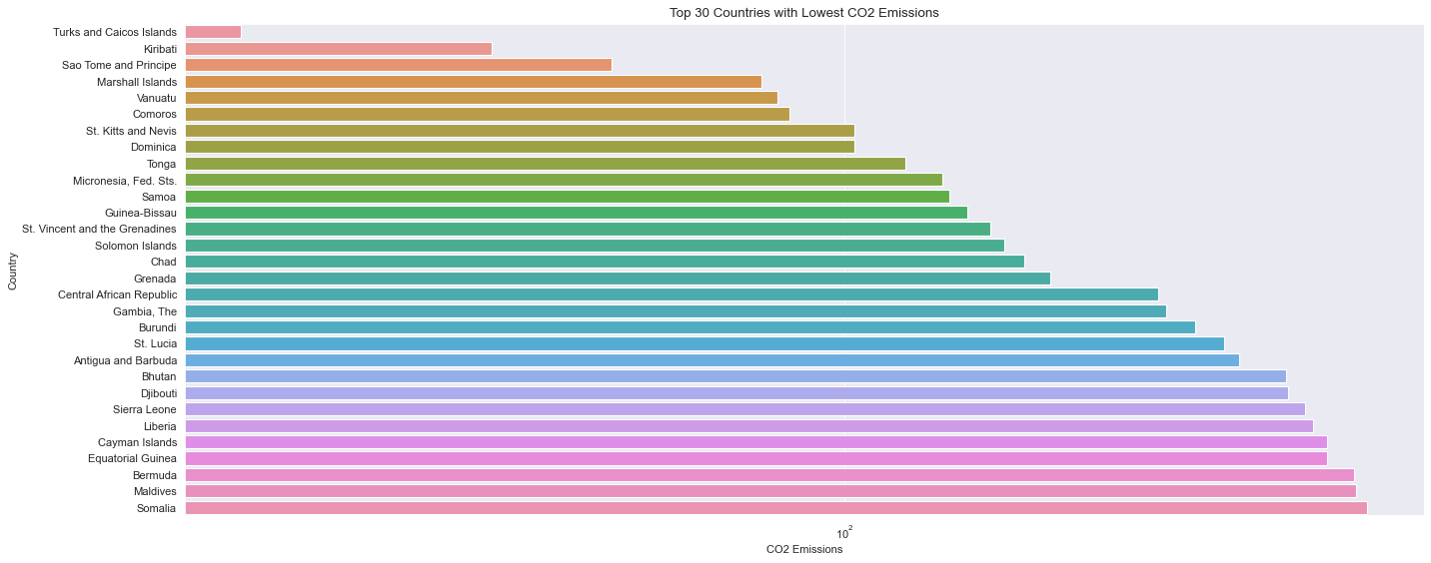
Insights
Top 30 countries with Highest &
Lowest CO2 Emission

Slide 23

Insights
Pair Plot is used to understand the best set of features to explain relationship between two variables or o form the most separated clusters

Slide 24
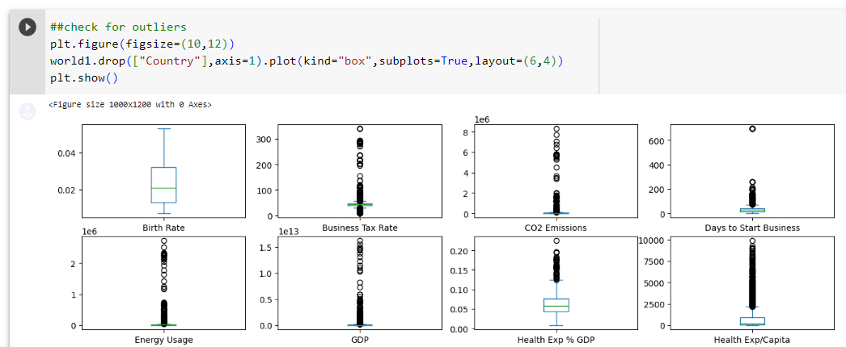
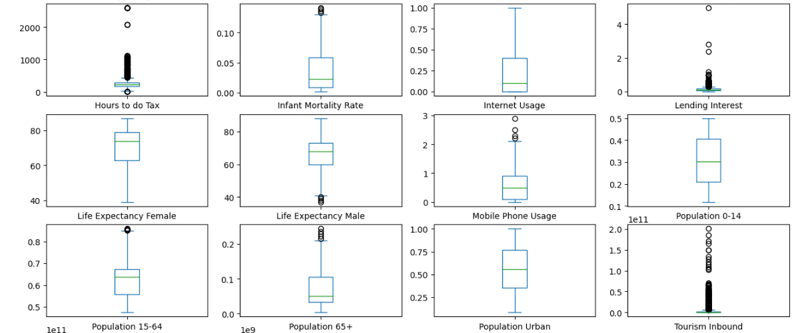
Checking for outliers
Notes:
Box plot is mainly used to check for the outliers present in the data.
Here, Birth Rate, Internet Usage, Population 0-14 and Population Urban does not have any outliers and all other features have the outliers.
If cluster data contains outliers then, the quality of the created clusters decreases significantly and outliers do not fit into the groups.

Slide 25
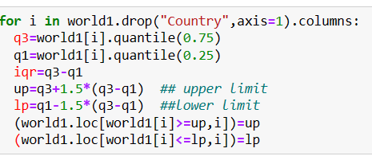
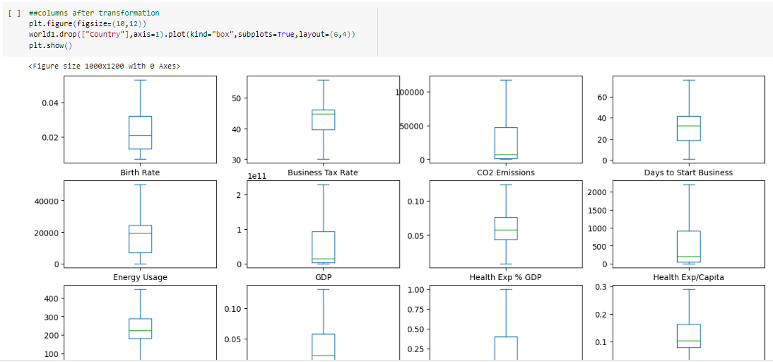
Treating outliers using iqr method.
After transformation

Slide 26
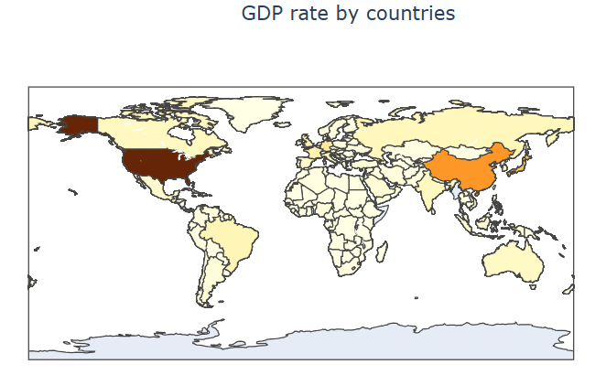
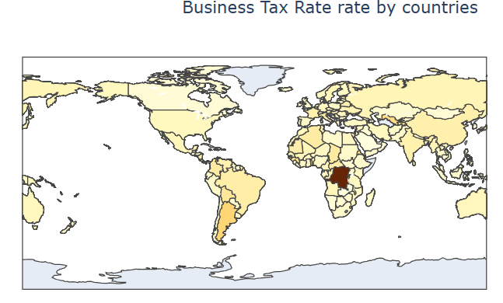
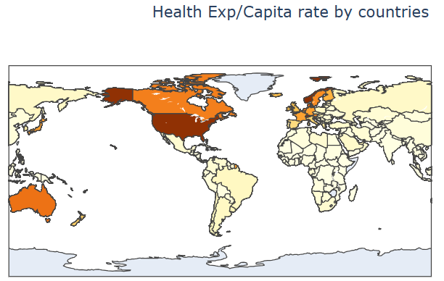
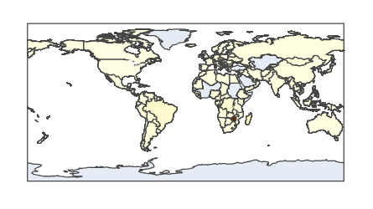
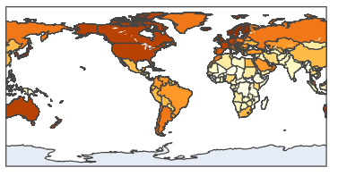
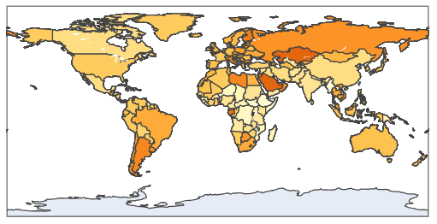
Country wise feature information using choropleth graph

Slide 27
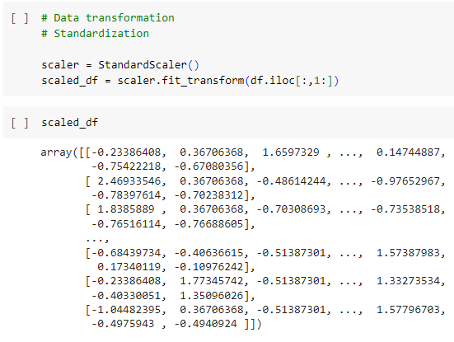
Data Standardization
Standardization will give importance to every features.
After standardization the range of values will be between -3 to +3.

Slide 28
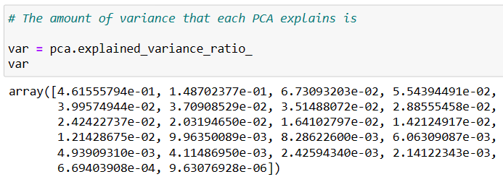
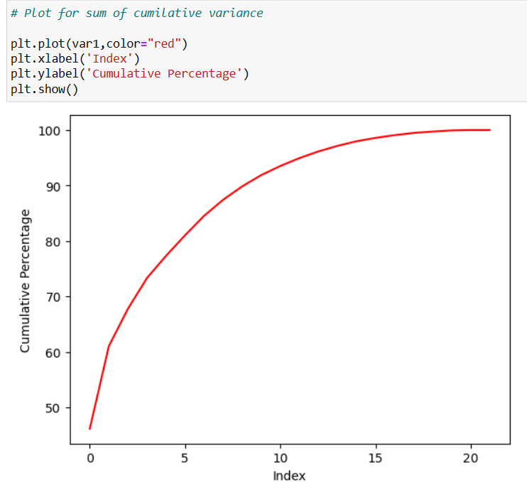
Dimensionality Reduction : PCA
We checked the variance of each components and plotted the cumulative variance. And found the by taking the first 13 columns we can retain more than 95% of data. So we will further building the model using these 13 features.

Slide 29
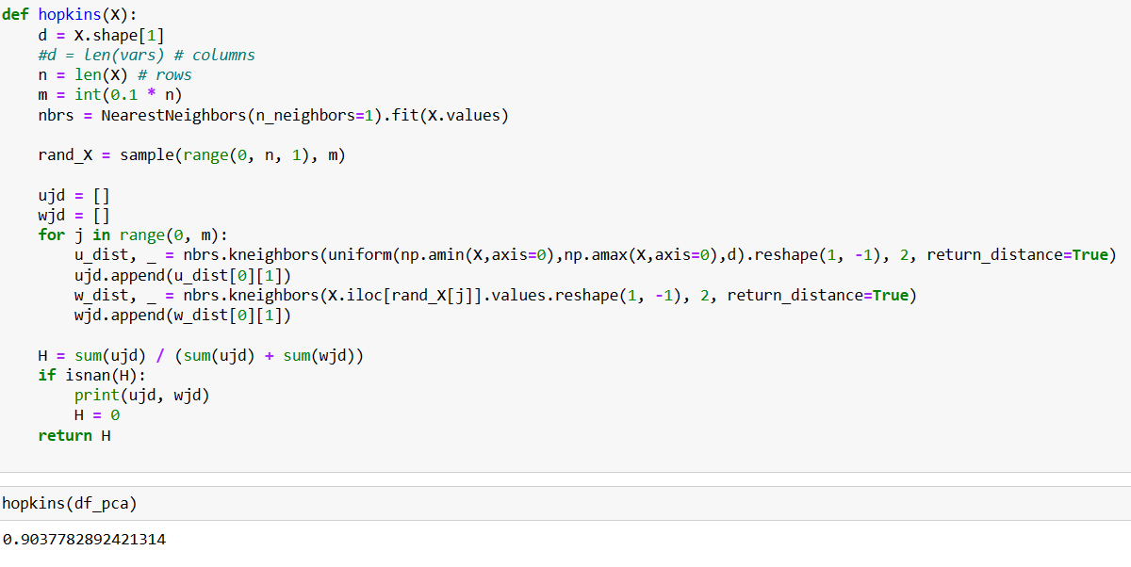
Hopkins Statistics for checking the clustering tendency
Here, the value for the hopkins test is near to 1. So it’s clear that the data is significantly a clusterable data

Slide 30
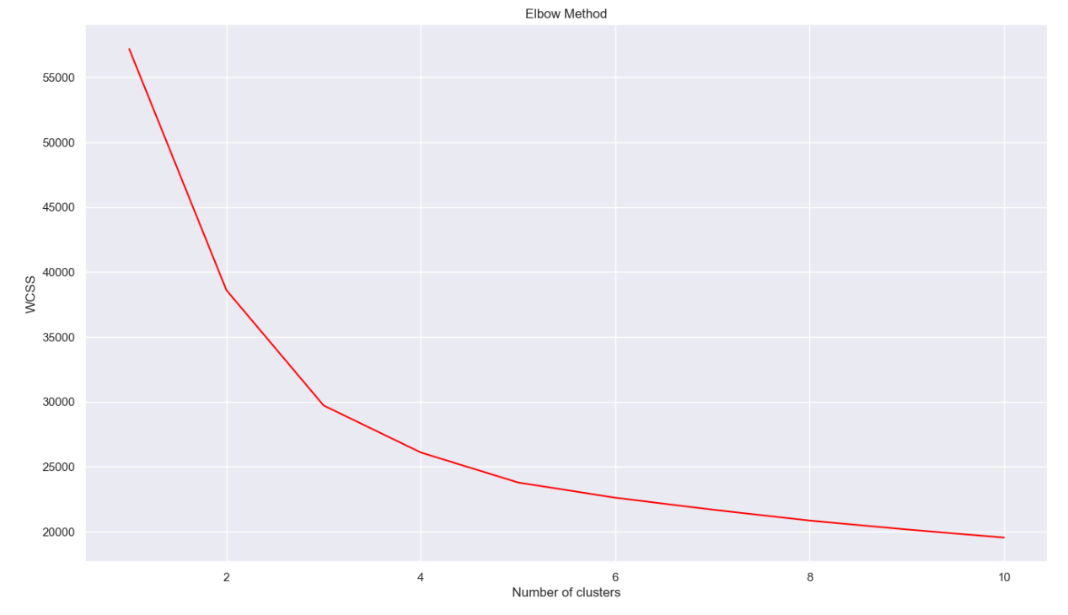
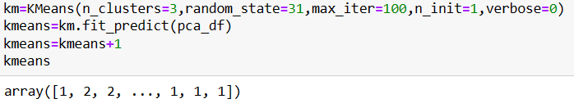
2) MODEL BUILDING
k-means clustering
Using elbow method to find the optimal no.of clusters. And the optimal no.of clusters is 3. So building the model with 3 clusters.

Slide 31
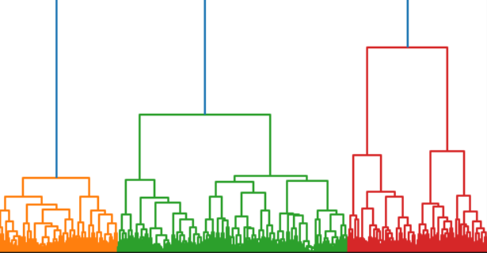
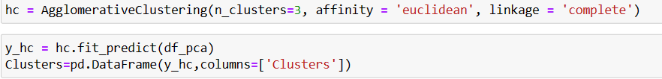
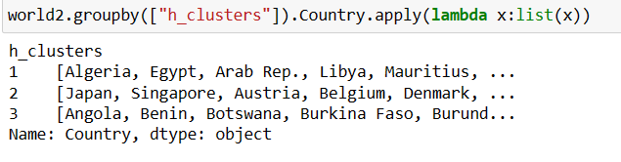
Hierarchical clustering
Using dendrogram to find the optimal no.of clusters.From dendrogram it’s clear that the optimal no.of clusters is 3. So building the model with 3 clusters

Slide 32
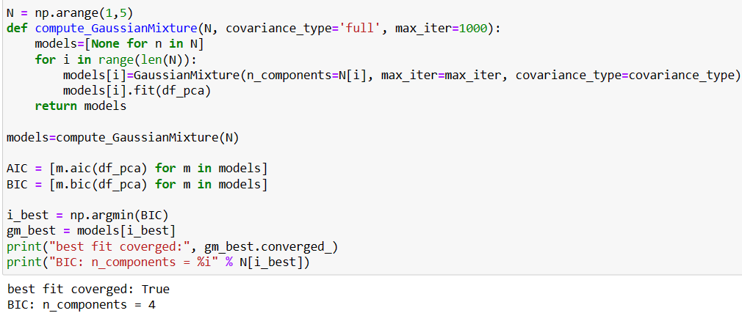

Gaussian Mixture Model clustering
Using AIC-BIC method to find the optimal no.of clusters. From this method it’s clear that the optimal no.of clusters is 4.So building the model using 4 clusters.

Slide 33


Dbscan clustering
Here, when we give the epsilon as 0.5 and minimum samples as 12, four clusters were formed. So building the model with 4 clusters.

Slide 34




Visualising the clusters using boxplot

Slide 35

3) MODEL EVALUATION
Here, we have used two metrics for model evaluation. They are silhouette method and Davies Bouldin index.
The low the Davies Bouldin Index score means the good the model is.
So, from here we found that the K-means clustering is having high accuracy, and this model creates good cluster for the global development measurement dataset.

Slide 36

since k means clustering is giving us the high silhouette score and lowest dbi score we are considering it for further analysis
In [ ]:
​

Slide 37


From the graph, we understood that,
Cluster 3 - Developed
Cluster 2 - Developing
Cluster 1 - Under developed

Slide 38


4)DEPLOYMENT

Slide 39


Deployment on localhost

Slide 40


Deployment on localhost

